Slide 1
Database - Normalization

Slide 2
Objectives
To Understand the Normalization process and apply while creating the databases.

Slide 3
Table of Content
Introduction to Database
Database Design
Normalization
ER Diagrams

Slide 4
Introducing the Database
Data Versus Information
Data constitute building blocks of information
Information produced by processing data
Information reveals meaning of data
Good, timely, relevant information key to decision making
Good decision making key to organizational survival

Slide 5
Database Management
Database is shared, integrated computer structure housing:
End user data
Metadata
Database Management System (DBMS)
Manages Database structure
Controls access to data
Contains query language

Slide 6
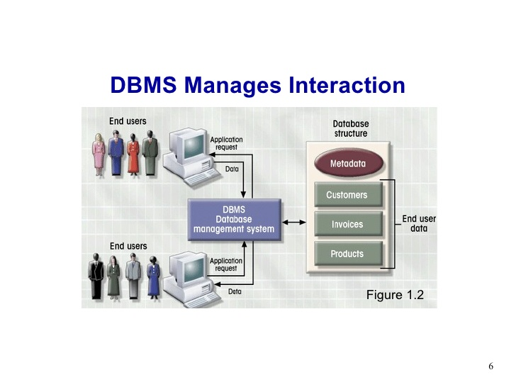
DBMS Interaction

Slide 7
Database Design
Importance of Good Design
Poor design results in unwanted data redundancy
Poor design generates errors leading to bad decisions
Practical Approach
Focus on principles and concepts of database design
Importance of logical design

Slide 8
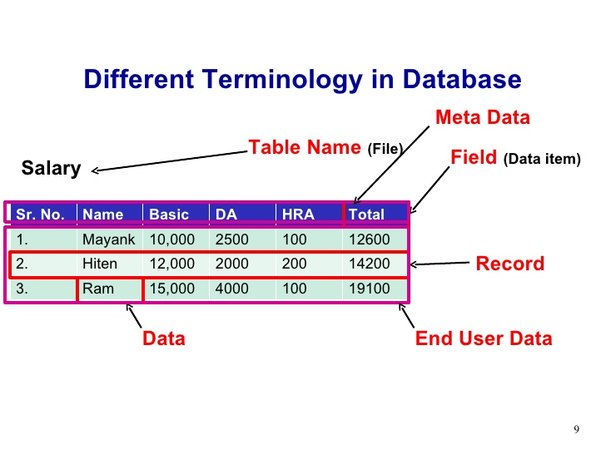
Different Terminology in database

Slide 9
Database System Types
Single-user vs. Multiuser Database
Desktop
Workgroup
Enterprise
Centralized vs Distributed
Use
Production or transactional
Decision support or data ware house

Slide 10
Phases of Database Design
Conceptual design begins with the collection of requirements and results needed from the database (ER Diag.)
Logical schema is a description of the structure of the database (Relational, Network, etc.)
Physical schema is a description of the implementation (programs, tables, dictionaries, catalogs

Slide 11
Models
A data model is a collection of objects that can be used to represent a set of data and operations to manipulate the data
Conceptual models are tools for representing reality at a very high-level of abstraction
Logical models are data descriptions that can be processed by computers

Slide 12
Conceptual Model – ER Diagram
Entities represent classes of real-world objects. Person, Students, Projects, Courses are entities of a University database
Relationships represent interactions between two or more entities

Slide 13
Example:
Every employee works in at least one project
Every project has employees working on it.

Slide 14
Higher-Order Relationships
A relationship may involve more than two entities

Slide 15
Recursive relationships
Relationships could be mapped from one entity to itself

Slide 16
Attributes
Attributes represent elementary properties of the entities or relationships. The stored data will be kept as values of the attributes

Slide 17
Contract-Supplies System
A company negotiates contracts with suppliers to provide certain amount of items at a fixed price
Orders are placed against any of the already negotiated contracts
A contract could provide items to any number of orders

Slide 18
Contract-Supplies System
An order may include any number of items negotiated in the contract
Orders should not exceed the maximum amount of items quoted in the contract
All items in an order must be provided as part of a single contract and a single project

Slide 19
Contract-Supplies System

Slide 20
Normalization
Database Normalisation is a technique of organizing the data in the database
Normalization is used for mainly two purpose,
Eliminating redundant(useless) data.
Ensuring data dependencies make sense i.e data is logically stored.

Slide 21
Problem without Normalization
Without Normalization, it becomes difficult to handle and update the database, without facing data loss.
Insertion, Updation and Deletion Anamolies are very frequent if Database is not Normalized.
To understand these anomalies let us take an example of Student table.

Slide 22
Example
S_id | S_Name | S_Address | Subject_opted
401 | Adam | Noida | Bio
402 | Alex | Panipat | Maths
403 | Stuart | Jammu | Maths
404 | Adam | Noida | Physics

Slide 23
Analmolies
Updation Anamoly : To update address of a student who occurs twice or more than twice in a table, we will have to update S_Address column in all the rows, else data will become inconsistent.
Insertion Anamoly : Suppose for a new admission, we have a Student id(S_id), name and address of a student but if student has not opted for any subjects yet then we have to insert NULL there, leading to Insertion Anamoly.
Deletion Anamoly : If (S_id) 401 has only one subject and temporarily he drops it, when we delete that row, entire student record will be deleted along with it.

Slide 24
Normalization Rule
Normalization rule are divided into following normal form.
1. First Normal Form
2. Second Normal Form
3. Third Normal Form
4. BCNF

Slide 25
First Normal Form (1NF)
As per First Normal Form, no two Rows of data must contain repeating group of information i.e each set of column must have a unique value, such that multiple columns cannot be used to fetch the same row. Each table should be organized into rows, and each row should have a primary key that distinguishes it as unique.
The Primary key is usually a single column, but sometimes more than one column can be combined to create a single primary key. For example consider a table which is not in First normal form.

Slide 26
Example not in 1NF
Student Table
Student | Age | Subject
Adam | 15 | Biology, Maths
Alex | 14 | Maths
Stuart | 17 | Maths

Slide 27
Convert to 1NF
In First Normal Form, any row must not have a column in which more than one value is saved, like separated with commas. Rather than that, we must separate such data into multiple rows.
.
Student | Age | Subject
Adam | 15 | Biology
Adam | 15 | Maths
Alex | 14 | Maths
Stuart | 17 | Maths
Using the First Normal Form, data redundancy increases, as there
will be many columns with same data in multiple rows but each row
as a whole will be unique.

Slide 28
Second Normal Form (2NF)
As per the Second Normal Form there must not be any partial dependency of any column on primary key.
It means that for a table that has concatenated primary key, each column in the table that is not part of the primary key must depend upon the entire concatenated key for its existence.
If any column depends only on one part of the concatenated key, then the table fails Second normal form.

Slide 29
In example of First Normal Form there are two rows for Adam, to include multiple subjects that he has opted for.
To achieve second normal form, it would be helpful to split out the subjects into an independent table, and match them up using the student names as foreign keys. .
Student Table
Subject Table
Student | Age
Adam | 15
Alex | 14
Stuart | 17
Student | Subject
Adam | Biology
Adam | Maths
Alex | Maths
Stuart | Maths
Notes:
In Student Table the candidate key will be Student column, because all other column i.e Age is dependent on it.
In Subject Table the candidate key will be {Student, Subject} column. Now, both the above tables qualifies for Second Normal Form and will never suffer from Update Anomalies. Although there are a few complex cases in which table in Second Normal Form suffers Update Anomalies, and to handle those scenarios Third Normal Form is there.

Slide 30
Third Normal Form (3NF)
Third Normal form applies that every non-prime attribute of table must be dependent on primary key, or we can say that, there should not be the case that a non-prime attribute is determined by another non-prime attribute.
So this transitive functional dependency should be removed from the table and also the table must be in Second Normal form.
For example, consider a table with following fields.
Student_id | Student_name | DOB | Street | city | State | Zip

Slide 31
Third Normal Form (3NF)
In this table Student_id is Primary key, but street, city and state depends upon Zip. The dependency between zip and other fields is called transitive dependency. Hence to apply 3NF, we need to move the street, city and state to new table, with Zip as primary key.
New Student Table
Student_id | Student_name | DOB | Zip
Address Table
Zip | Street | city | state
The advantage of removing transtive dependency is,
Amount of data duplication is reduced.
Data integrity achieved.
Notes:
The advantage of removing transtive dependency is,
Amount of data duplication is reduced.
Data integrity achieved.

Slide 32
Boyce and Codd Normal Form (BCNF)
Boyce and Codd Normal Form (BCNF)
Boyce and Codd Normal Form is a higher version of the Third Normal form. This form deals with certain type of anamoly that is not handled by 3NF. A 3NF table which does not have multiple overlapping candidate keys is said to be in BCNF.
For a table to be in BCNF, following conditions must be satisfied:
R must be in 3rd Normal Form
and, for each functional dependency ( X -> Y ), X should be a super Key.
Notes:
Third Normal Form is violated
If there exists a partial key which is functionally dependent on a non-key field(s).
non-key partial-key

Slide 33
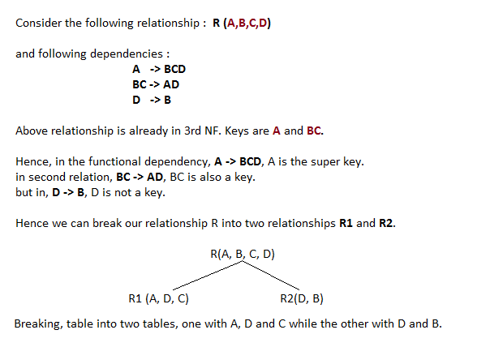
BCNF Contd..
.

